Slide 1
Tensorflow
(System Design)
in Deep Learning:-

Slide 2
Tensorflow (System Design):-
In Tensorflow system design there’s three types of terminologies available which helps to create Tensorflow System :-
Server Nodes:- So in server node whatever the information we are going to create it redirect to Server Node. It’s kind of resource manager who provide task to Worker Node and once Worker Node done with the task they pass it back to Server Node.
Worker Node:- As above mentioned. So Worker Node take task from Server Node and then once it done with task it provide back to Server Node.
Data:- Data is for requirement to fullill the task which provided.

Slide 3
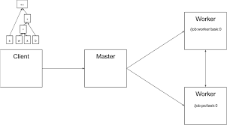
Tensorflow System Design (Diagram):-

Slide 4
Types of Tensor are:-
In Tensorflow everything consider as Tensor. So basically there’s three types of Tensors are available:-
Rank:- It’s dimension of the Particular object like 1d, 2d, 3d etc.
Shape:- Shape are the rows and columns available in Tensor.
Type:- In Tensor here we’ll get to know what datatype we are using it’s integer, string or float.

